Slide 1

Geometry
Unit 3, Lesson 8 Angle Relationship Proofs – Part 1 Volume 1, pg. 164

Slide 2


Benchmarks
MA.912.GR.1.1
Prove relationships and theorems about lines and angles. Solve mathematical and real-world problems involving postulates, relationships, and theorems of lines and angles.
MA.912.LT.4.10
Judge the validity of arguments and give counterexamples to disprove statements.
volume 1, pg. 164

Slide 3
Integrated Mathematical Thinking and Reasoning Standards
MA.K12.MTR.1.1 Actively participate in effortful learning both individually and collectively.
MA.K12.MTR.2.1 Demonstrate understanding by representing problems in multiple ways.
MA.K12.MTR.4.1 Engage in discussions that reflect on the mathematical thinking of self and others.
MA.K12.MTR.5.1 Use patterns and structure to help understand and connect mathematical concepts.
MA.K12.MTR.6.1 Assess the reasonableness of solutions.
volume 1, pg. 164

Slide 4

Learning Target
I can prove relationships using parallel lines and their transversals.
volume 1, pg. 164

Slide 5

Warm-Up
volume 1, pg. 164

Slide 6
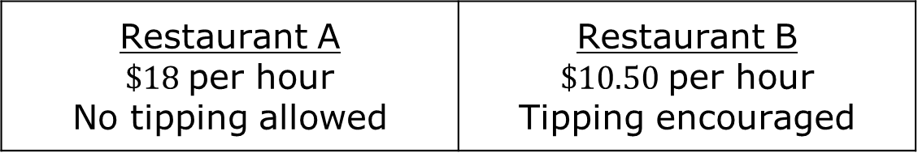

3.8.1 Warm-Up: Would You Rather?
The meals at two restaurants range from $\$8.00$ to $\$25.00$. Servers are paid based on the following.
Would you rather work as a server at Restaurant A or at Restaurant B? Justify your choice.
Restaurant A $\$18$per hour No tipping allowed | Restaurant B $\$10.50$per hour Tipping encouraged
volume 1, pg. 164

Slide 7

Collaboration
volume 1, pg. 165

Slide 8

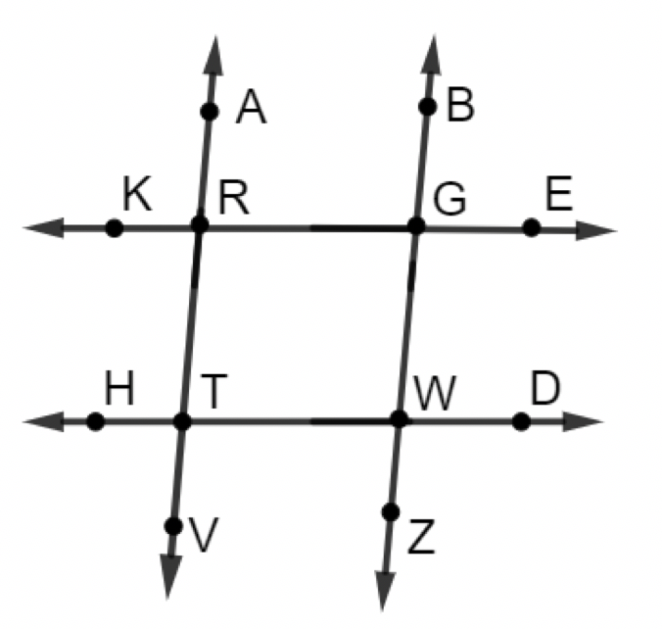
3.8.2 Collaboration: Parallel Lines
Contradictory information is given for the figure. $\overset{⃡}{KE}∥\overset{⃡}{HD}$, $∠KRA≅∠BGE$, $∠TRG$ is a supplement of $∠RGW$, and $m∠DWZ=87°$.
What piece of information is contradictory?
How do you know it is contradictory?
Share your contradiction with your partner. Discuss any differences.
volume 1, pg. 165

Slide 9
Create four different pieces of information about this figure using $\overset{⃡}{AV}∥\overset{⃡}{BZ}$. One of the pieces of information should be contradictory.
1.
2.
3.
4.
volume 1, pg. 165

Slide 10
Trade information with a partner and see if your partner can find the contradiction. Write their contradiction in the table.
Partner’s Contradiction | Partner’s Initials
volume 1, pg. 165

Slide 11
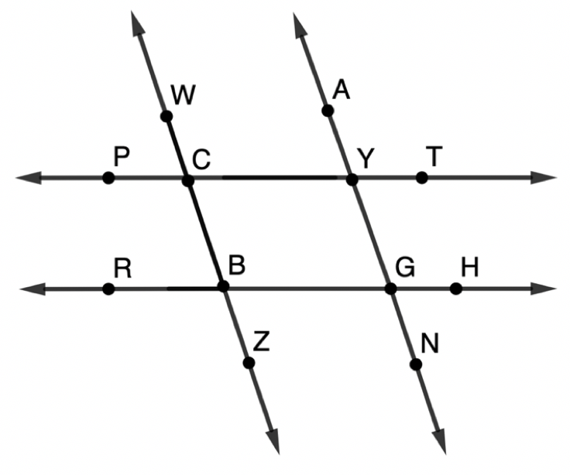
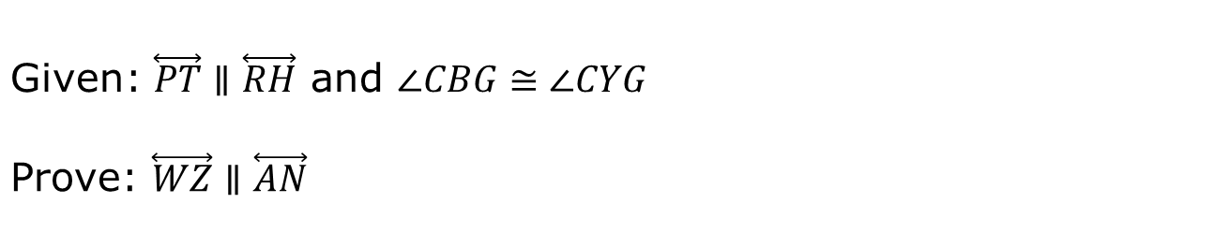
Terrence was organizing a card sort for the proof, but his cards fell on the floor and are now out of order.
Given: $\overset{⃡}{PT}∥\overset{⃡}{RH}$ and $∠CBG≅∠CYG$
Prove: $\overset{⃡}{WZ}∥\overset{⃡}{AN}$
volume 1, pg. 166

Slide 12
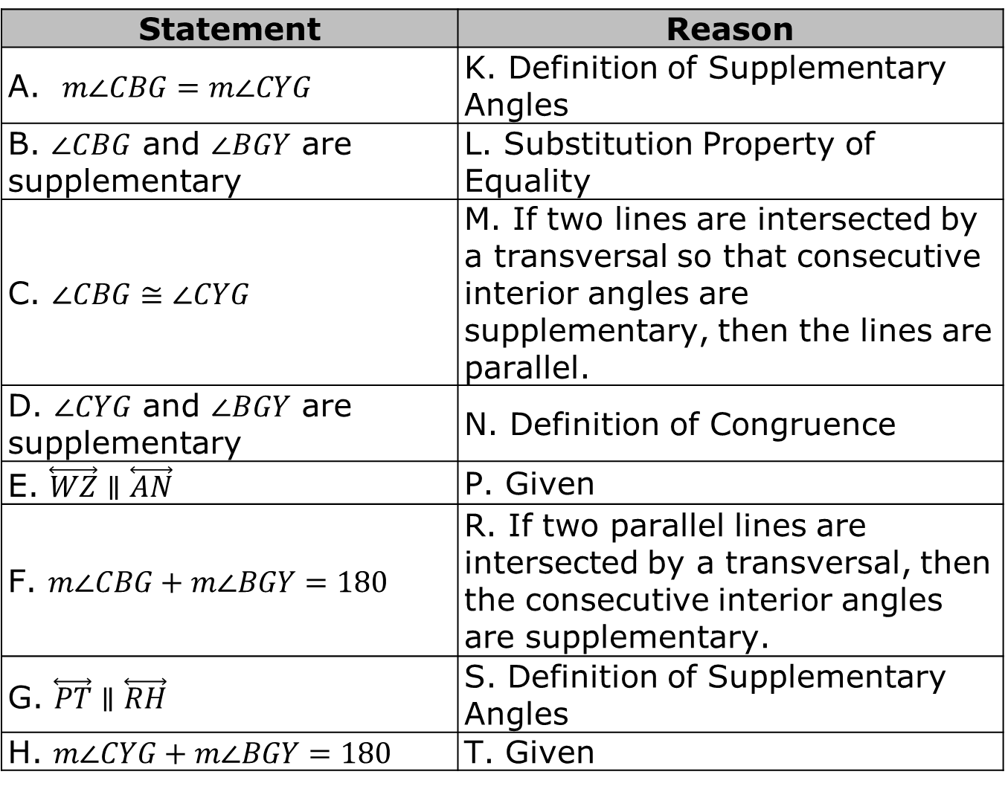
Statement | Reason
A. $m∠CBG=m∠CYG$ | K. Definition of Supplementary Angles
B. $∠CBG$ and $∠BGY$ are supplementary | L. Substitution Property of Equality
C. $∠CBG≅∠CYG$ | M. If two lines are intersected by a transversal so that consecutive interior angles are supplementary, then the lines are parallel.
D. $∠CYG$ and $∠BGY$ are supplementary | N. Definition of Congruence
E. $\overset{⃡}{WZ}∥\overset{⃡}{AN}$ | P. Given
F. $m∠CBG+m∠BGY=180$ | R. If two parallel lines are intersected by a transversal, then the consecutive interior angles are supplementary.
G. $\overset{⃡}{PT}∥\overset{⃡}{RH}$ | S. Definition of Supplementary Angles
H. $m∠CYG+m∠BGY=180$ | T. Given
volume 1, pg. 166

Slide 13
Work with your partner to correctly place the statements and reasons in the correct order by writing the letter.
Statement | Reason
1. | 1.
2. | 2.
3. | 3.
4. | 4.
5. | 5.
6. | 6.
7. | 7.
8. | 8.
volume 1, pg. 166

Slide 14
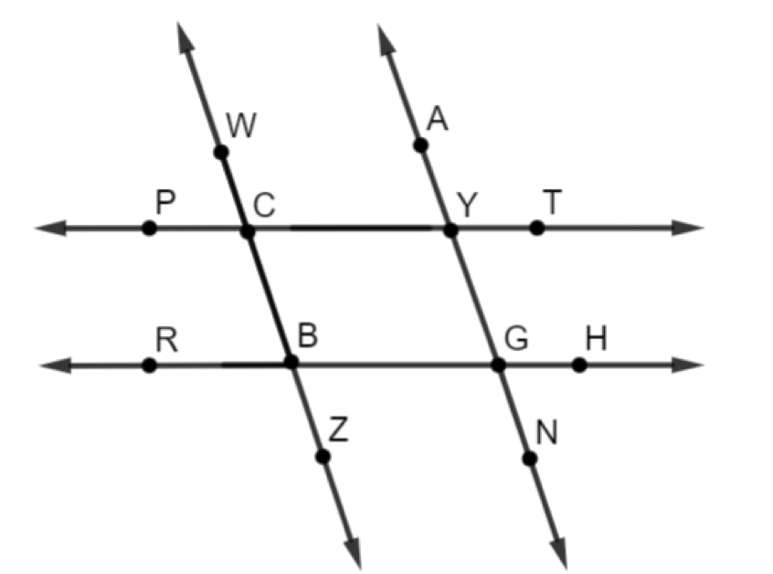
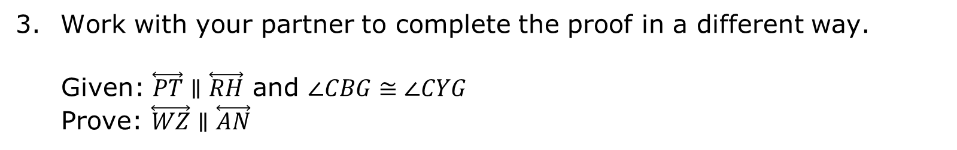
Work with your partner to complete the proof in a different way.
Given: $\overset{⃡}{PT}∥\overset{⃡}{RH}$ and $∠CBG≅∠CYG$
Prove: $\overset{⃡}{WZ}∥\overset{⃡}{AN}$
volume 1, pg. 167

Slide 15
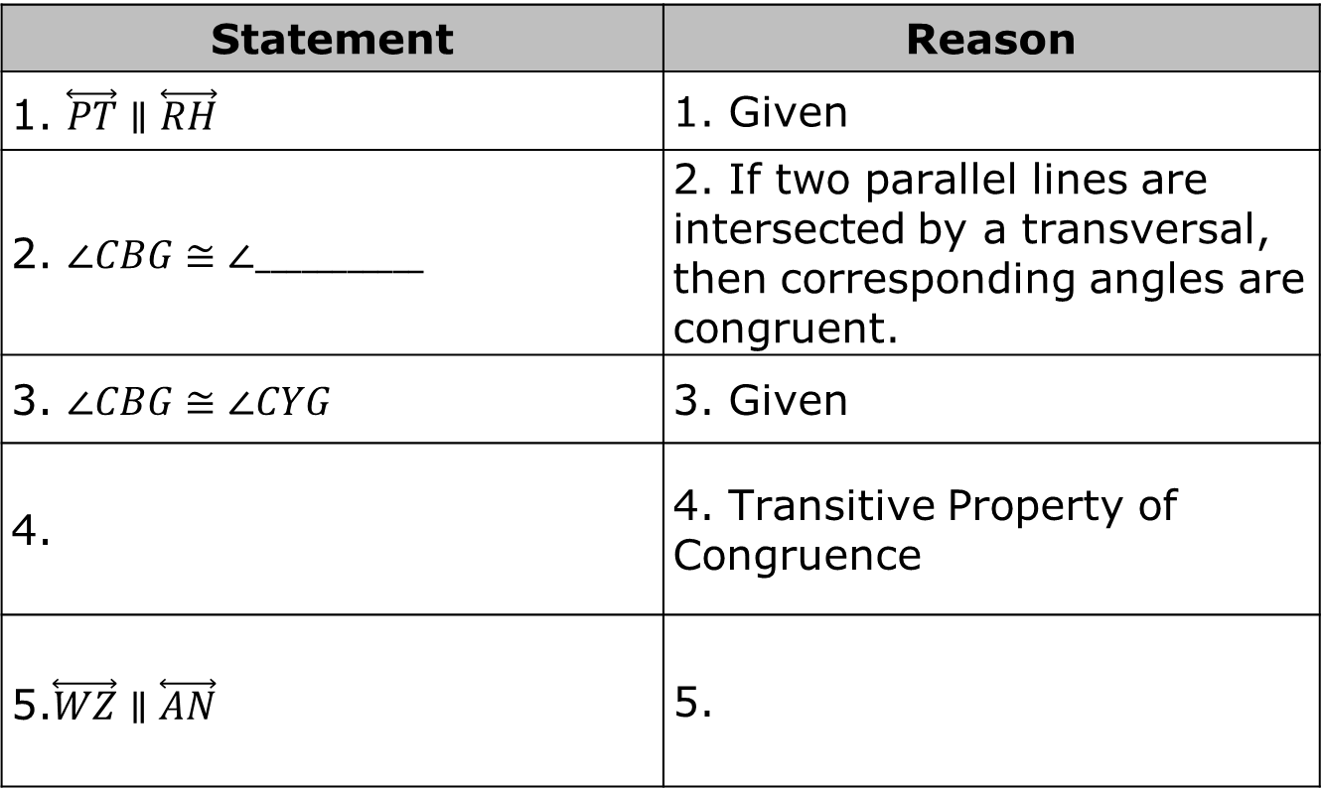
Statement | Reason
1. $\overset{⃡}{PT}∥\overset{⃡}{RH}$ | 1. Given
2. $∠CBG≅∠___________$ | 2. If two parallel lines are intersected by a transversal, then corresponding angles are congruent.
3. $∠CBG≅∠CYG$ | 3. Given
4. | 4. Transitive Property of Congruence
5.$\overset{⃡}{WZ}∥\overset{⃡}{AN}$ | 5.
volume 1, pg. 167

Slide 16

Guided Instruction
volume 1, pg. 167

Slide 17
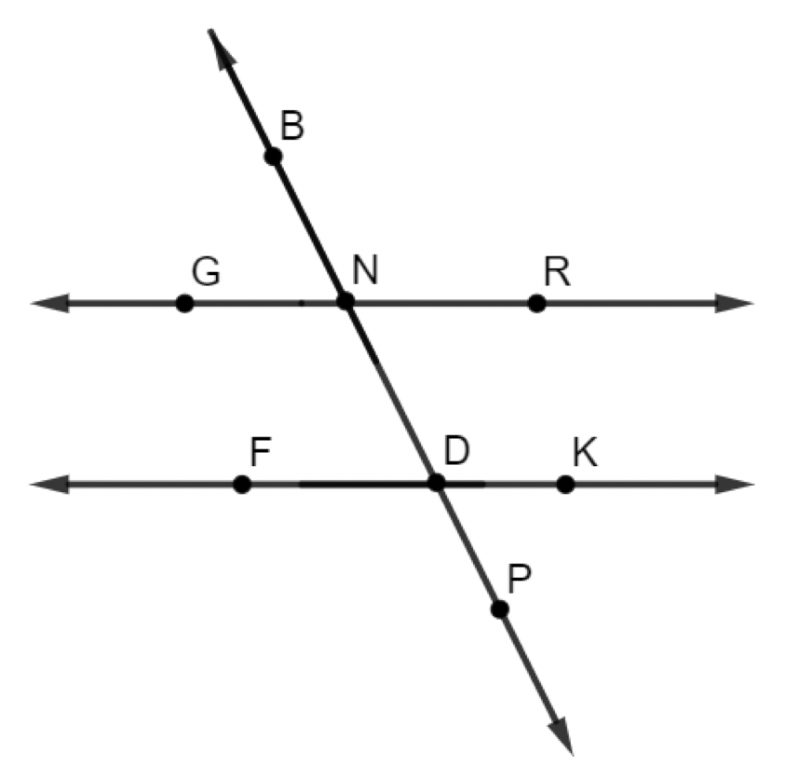
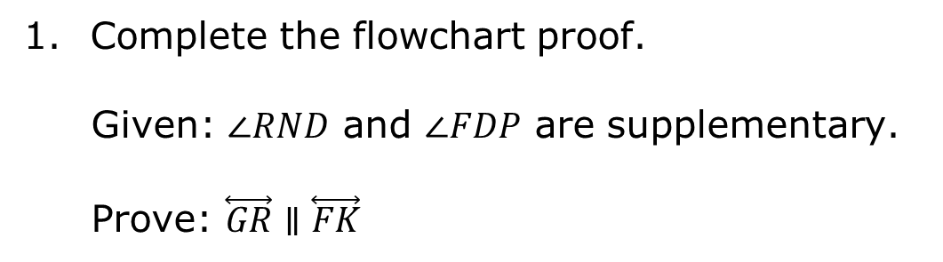
3.8.3 Guided Instruction: Proofs Involving Angle Relationship
Complete the flowchart proof.
Given: $∠RND$ and $∠FDP$ are supplementary.
Prove: $\overset{⃡}{GR}∥\overset{⃡}{FK}$
volume 1, pg. 167

Slide 18
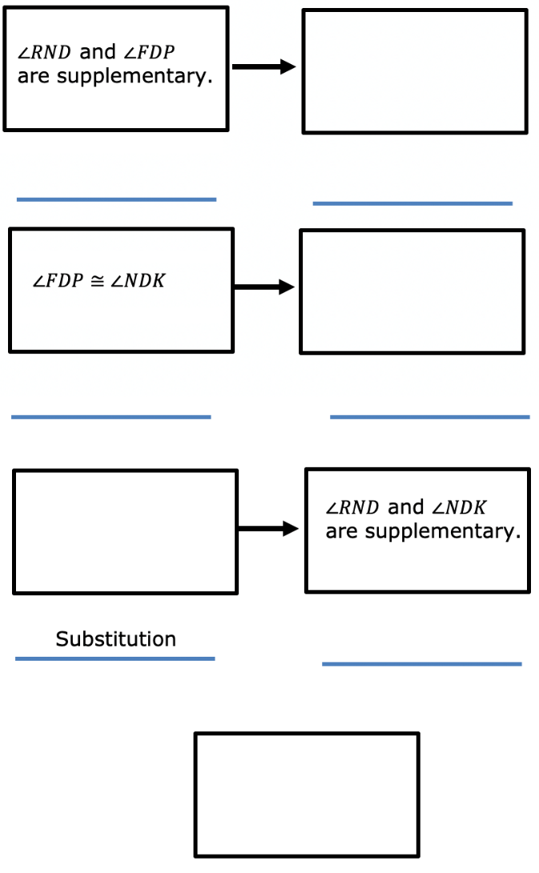
volume 1, pg. 168

Slide 19
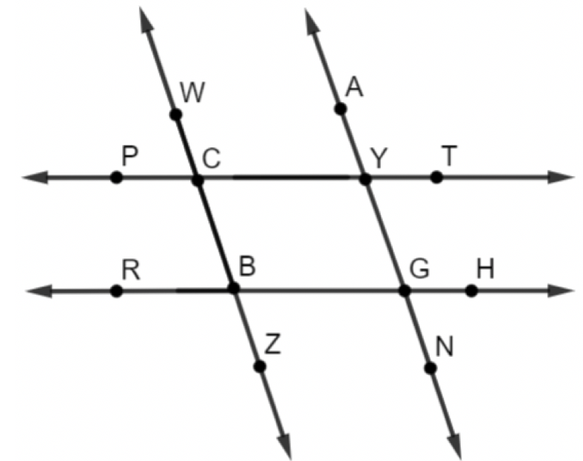
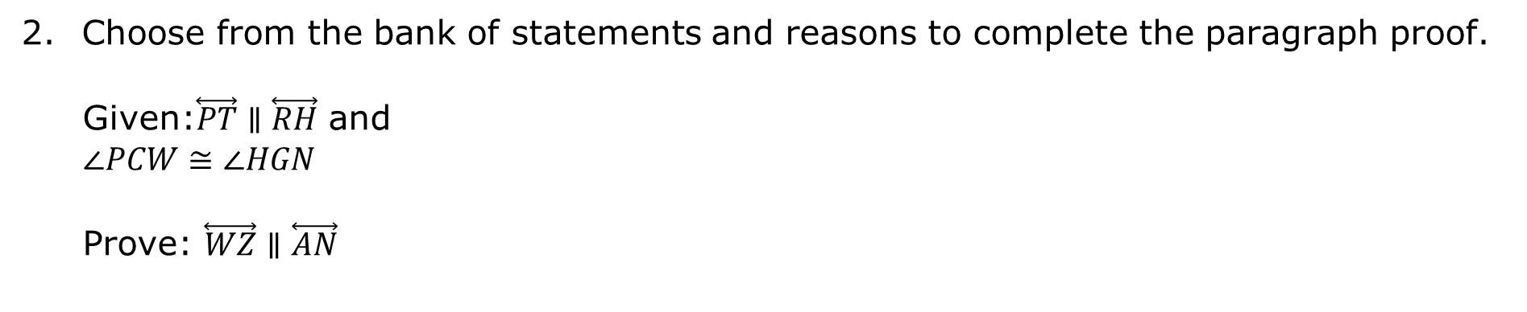
Choose from the bank of statements and reasons to complete the paragraph proof.
Given:$\overset{⃡}{PT}∥\overset{⃡}{RH}$ and
$∠PCW≅∠HGN$
Prove: $\overset{⃡}{WZ}∥\overset{⃡}{AN}$
volume 1, pg. 168

Slide 20
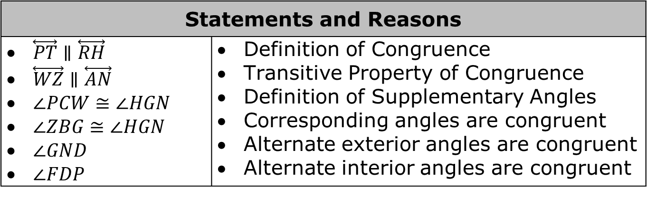
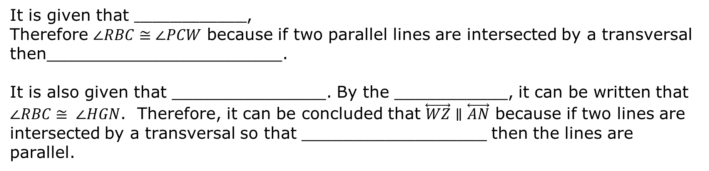
It is given that $___________________$,
Therefore $∠RBC≅∠PCW$ because if two parallel lines are intersected by a transversal then_______________________.
It is also given that _______________. By the ___________, it can be written that $∠RBC≅ ∠HGN$. Therefore, it can be concluded that $\overset{⃡}{WZ}∥\overset{⃡}{AN}$ because if two lines are intersected by a transversal so that __________________ then the lines are parallel.
Statements and Reasons
$\overset{⃡}{PT}∥\overset{⃡}{RH}$ $\overset{⃡}{WZ}∥\overset{⃡}{AN}$ $∠PCW≅∠HGN$ $∠ZBG≅∠HGN$ $∠GND$ $∠FDP$ | Definition of Congruence Transitive Property of Congruence Definition of Supplementary Angles Corresponding angles are congruent Alternate exterior angles are congruent Alternate interior angles are congruent
volume 1, pg. 168

Slide 21

Wrap-Up
volume 1, pg. 169

Slide 22
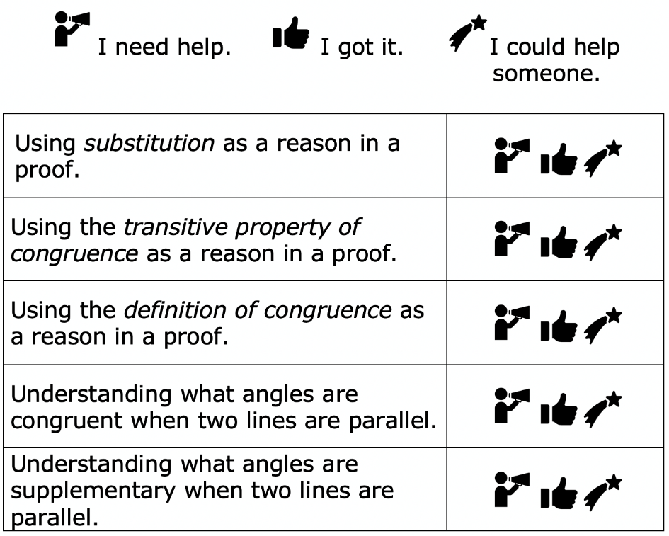
3.8.4 Wrap-Up: Reflection
Circle the icon that best describes your understanding of each concept.
volume 1, pg. 169

